Slide 1

Analysis for Opening New Restaurant
Presented by –
Manem Sai Chaitanya
15 February 2024

Slide 2
Data Snapshot
Total number of counties in the analysis – 15 countries.
Total number of Restaurants for the analysis – 9551.
The Data is available for 9 different years.

Slide 3
Data Cleaning and Processing
Have hide the column – Address(F), Locality(G), LocalityVerbose(H) , Longitude(I), Latitude(J). As are not using these respective columns for further analysis.
In Cuisines column, 8 cells were missing, all the cuisines belong to one specific country, which is United States of America, and on further analysis we observer that American the most frequently occurring type of cuisine in restaurants based in the United States of America. So I decided to consider American for the missing cells in Cuisine column.
Extracted Currency Symbol from Existing Currency Column using Text-to-column.
Using find and replace, corrected the Datekey-opening column.
Extacted Year from Datekey-open column using text function.

Slide 4
Analytical Approach and tools
Data Cleaning – Utilized functions like – Trim, Hide, Text, Find & Replace
Data Enrichment- Enhanced the dataset with additional functions like Lookup functions, If aggregate functions, Other confitional aggregation functions like Sumif, Average if, Countif, etc.
Discriptive Analysis – For further enhancement, pivot table were used for
Key matrix and understanding the changes in patterns across all the categories.
Country segmentations – Applies SORT and FILTER function.
Visulaitation – Created dashboard using pivot charts for data representation.

Slide 5
Number of Restaurants Opened in Each Country
As per my analysis, I found that India is leading with 8652 opened restaurants, and,
USA is the 2nd highest with 434 opened restaurants.

Slide 6
Number of Restaurants Opened in Each Year
As per my analysis, I found that in the year 2018, highest number of restaurants were opened, which is 1102 restaurants.
After that in 2011 is the year were 1098 Restaurants were opened.

Slide 7
Countries with lesser Competition
I will suggest only these 4 countries as lesser competition for Zomato.
As per my findings, Australia has highest no. of opened restaurants, which is 24 opened restaurants.
Sri Lanka is leading in Average of ratings for the restaurants, which is 3.87 rating.
And, Canada is the top performer country, as it has 4 opened restaurants and 3. 58 rating as average of rating.

Slide 8
Countries with Average Ratings
As per the analysis Indian have more no. of Opened restaurants, but at the same time India also have least no. of Average ratings of restaurant.
Philippines is the highest Average rating Country.

Slide 9
Financial Expenditure
For opening a new restaurant in any of these following 4 countries, Zomato should keep there financial expenditure in control.
For Australia it should be Rs. 31269.8.
For Canada it should be Rs. 8947.95.
For Singapore it should be Rs. 192195.5.
For Sri Lanka it should be Rs. 12350.

Slide 10
Conclusion
As per the Lesser competition analysis, I will say that Canada is the best place to start a new restaurant for Zomato as Canada is the top performer country, as it has 4 opened restaurants and 3.58 rating as average of rating.
And if Zomato will open its new restaurant in Canada, there are high chances of audience trying to the new restaurant, and as competition wise also there are only 4 opened restaurants.
And in terms of Financial expenditure also, Canada will be needing less amount which should be Rs. 8947.95, which is very less as compared to all the 3 countries.

Slide 11
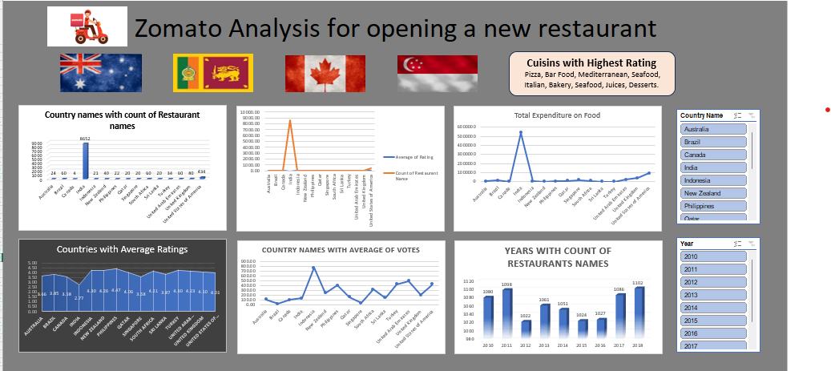
Excel Dashboard

Slide 12
Thank You

